Slide 1


<Name>
<Date>

Slide 2

Outline
Executive Summary
Introduction
Methodology
Results
Conclusion
Appendix

Slide 3
Executive Summary
Summary of methodologies
Methodologies included Data Collection
Data Collection with web scraping
Data Wrangling, Exploratory Data Analysis with SQL and Visualization, Building Interactive Dashboards and Predictive Machine Learning Tools
Summary of all results
Data was collected that allowed us to come to valuable conclusions regarding the data’s accuracy and which parts of the data were most important

Slide 4
Introduction
Project background and context
Space X is an incredibly successful company that does rocket launches. However you are a member of Space Y and you want to find out using Public information whether or not Space X can reuse their rockets. This would allow us to find out how much something will cost and whether or not at space y we could replicate the success of space x
Problems you want to find answers
How do different variables such as mass and orbits effect rocket success. Additionally how much does it cost and what prediction model is best at predicting the cost.

Slide 5

Section 1

Slide 6
Methodology
Executive Summary
Data collection methodology:
We used the spaceX api and wikipedia web scraping to do this
Perform data wrangling
We got rid of missing values and assigned different outcomes to different classes to translate the outcome to a binary number
Perform exploratory data analysis (EDA) using visualization and SQL
Perform interactive visual analytics using Folium and Plotly Dash
Perform predictive analysis using classification models
We then fed the data to different classification models and worked to find which one had the highest accuracy of all of them

Slide 7
Data Collection
Describe how data sets were collected.
We got the data via the spaceX api and web scraping wikipedia. We used the api and web scraping to get key information that pertained to the different elements that are important in deciding whether or not the rocket will succeed
You need to present your data collection process use key phrases and flowcharts

Slide 8
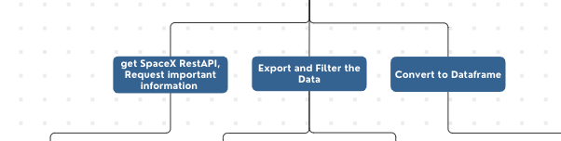
Data Collection – SpaceX API
We got the SpaceX API requested important information and then exported the data, filtered it for falcon 9 launches and converted it to a dataframe
Add the GitHub URL of the completed SpaceX API calls notebook (must include completed code cell and outcome cell), as an external reference and peer-review purpose
Place your flowchart of SpaceX API calls here

Slide 9
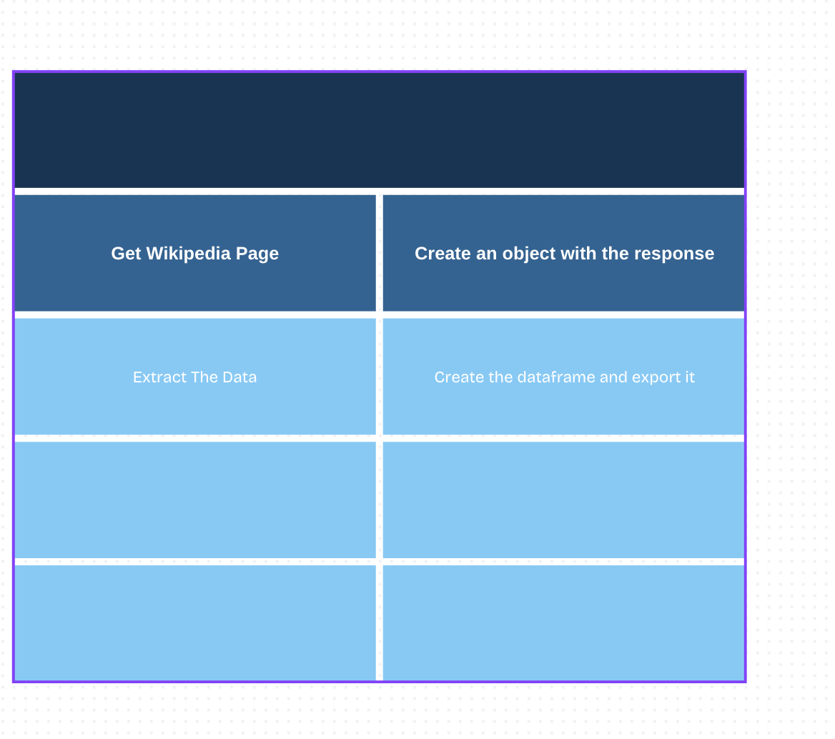
Data Collection - Scraping
To do this webscraping we got the Wikipedia page, we created an object with the response we got, extracted the data, created the data frame and then exported it
Add the GitHub URL of the completed web scraping notebook, as an external reference and peer-review purpose
Place your flowchart of web scraping here

Slide 10
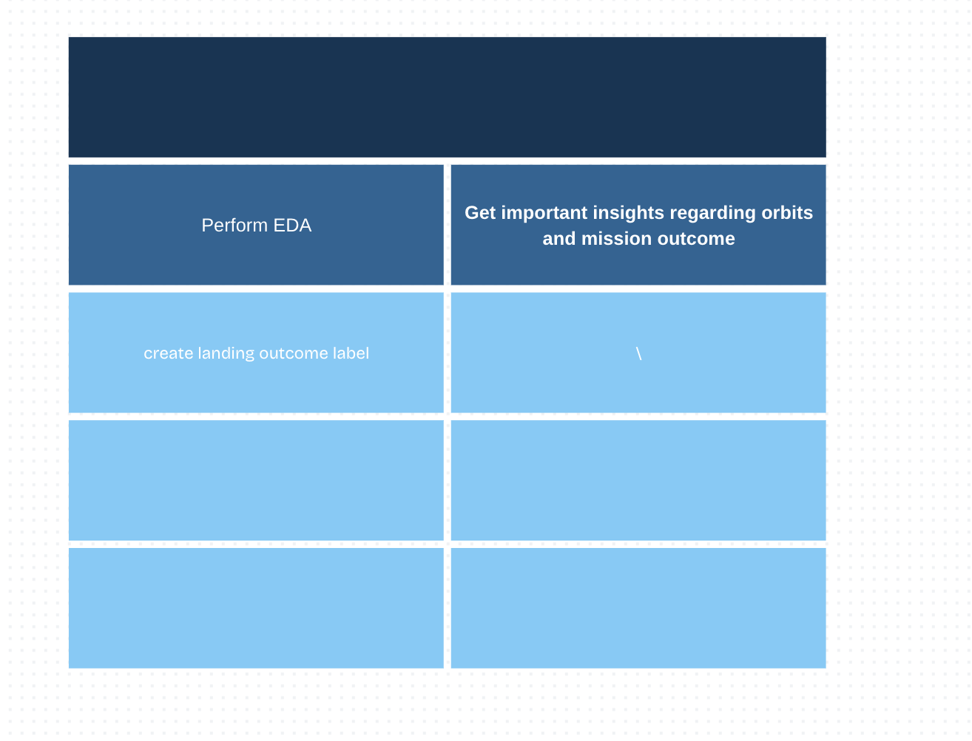
Data Wrangling
We did the data wrangling by performing exploratory data Analysis. We then used this to gain important insights regarding orbits, mission outcomes and the number of launches.
We then created a label for the landing outcome.

Slide 11
EDA with Data Visualization
We used bar and scatter plots to visualize the relationship between different features including orbit and flight number, launch site and mass, launch site and flight number.
Add the GitHub URL of your completed EDA with data visualization notebook, as an external reference and peer-review purpose

Slide 12
EDA with SQL
Using bullet point format, summarize the SQL queries you performed
Names of the unique launch sites in the space mission
Top 5 launch sites whose name begin with the string 'CCA'
Average payload mass carried by booster version F9 v1.1;
Total payload mass carried by boosters launched by NASA (CRS);
Date when successful landing outcome in ground pad was achieved;
Names of boosters which have success in drone ship and payload mass between 4000 and 6000 kg;
Number of successful and failure mission outcomes;
Names of the booster versions which have carried the maximum payload mass;
Failed landing outcomes in drone ship, their booster versions, and launch site names for in year 2015; and
Rank of the count of landing outcomes (such as Failure (drone ship) or Success (ground pad)) between the date 2010-06-04 and 2017-03-20.
Add the GitHub URL of your completed EDA with SQL notebook, as an external reference and peer-review purpose

Slide 13
Build an Interactive Map with Folium
Summarize what map objects such as markers, circles, lines, etc. you created and added to a folium map
Markers were used to focus on specific points like launch sites, We used circles to add greater emphasis to these areas, We used clusters to differentiate between success and failure. We added lines to indicate distance.
Explain why you added those objects
Add the GitHub URL of your completed interactive map with Folium map, as an external reference and peer-review purpose

Slide 14
Build a Dashboard with Plotly Dash
Summarize what plots/graphs and interactions you have added to a dashboard
I added a launch site dropdown so that people could choose different launch sites.
Then I added a pie chart that shows what percentage of launches were successful
Then I added a slider that showed how payload correlated with success before adding a callback that made a scatter plot for payload’s correlation with success at different sites
Explain why you added those plots and interactions
Add the GitHub URL of your completed Plotly Dash lab, as an external reference and peer-review purpose

Slide 15
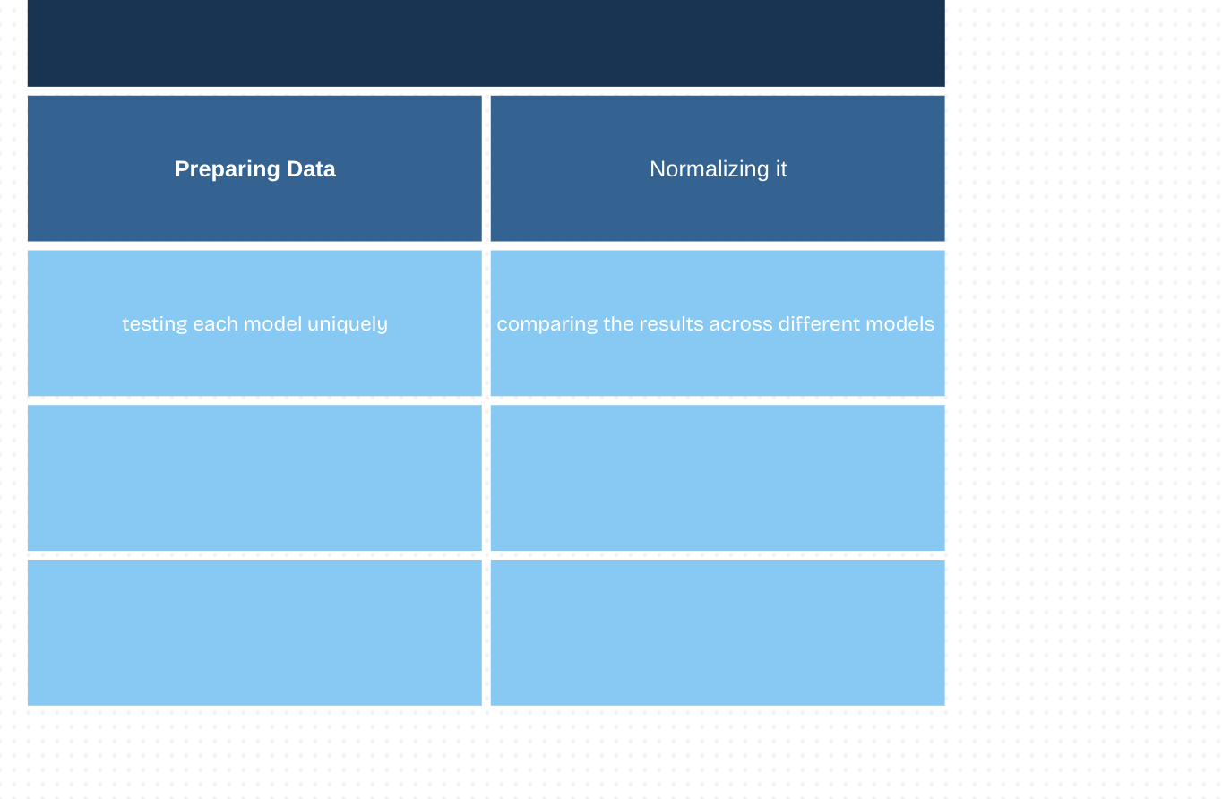
Predictive Analysis (Classification)
Summarize how you built, evaluated, improved, and found the best performing classification model
We compared logistic regression with support vector machine, decision tree and k nearest neighbours. We did this to find the most accurate model
You need present your model development process using key phrases and flowchart
Add the GitHub URL of your completed predictive analysis lab, as an external reference and peer-review purpose

Slide 16
Results
Exploratory data analysis results
Interactive analytics demo in screenshots
Predictive analysis results

Slide 17

Section 2

Slide 18
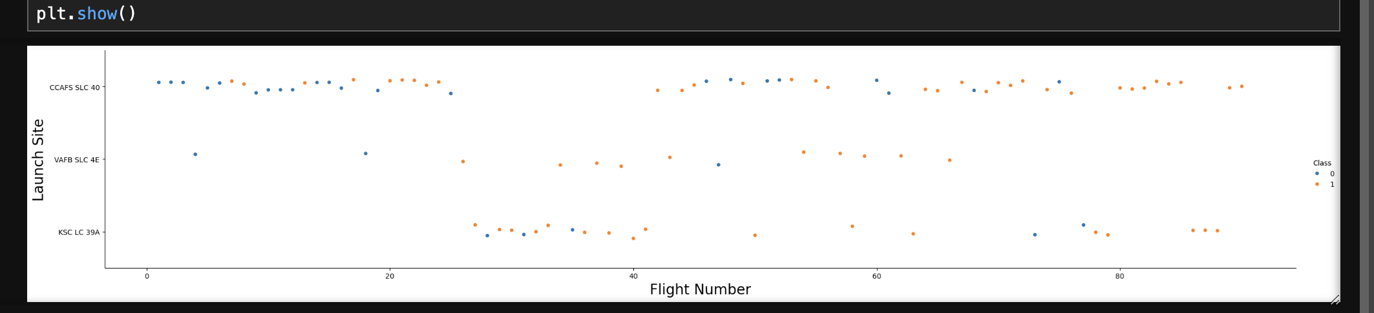
Flight Number vs. Launch Site
The later the flight number the better it did
VAFB and KSC are more successful
CCAFS has a majority of launches
Show the screenshot of the scatter plot with explanations

Slide 19
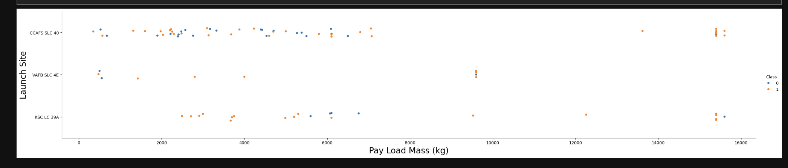
Payload vs. Launch Site
Payload has a positive correlation with success
KSC and CCAFS tend to have higher payloads
Most payloads over 8000kg tend to be successful
Show the screenshot of the scatter plot with explanations

Slide 20
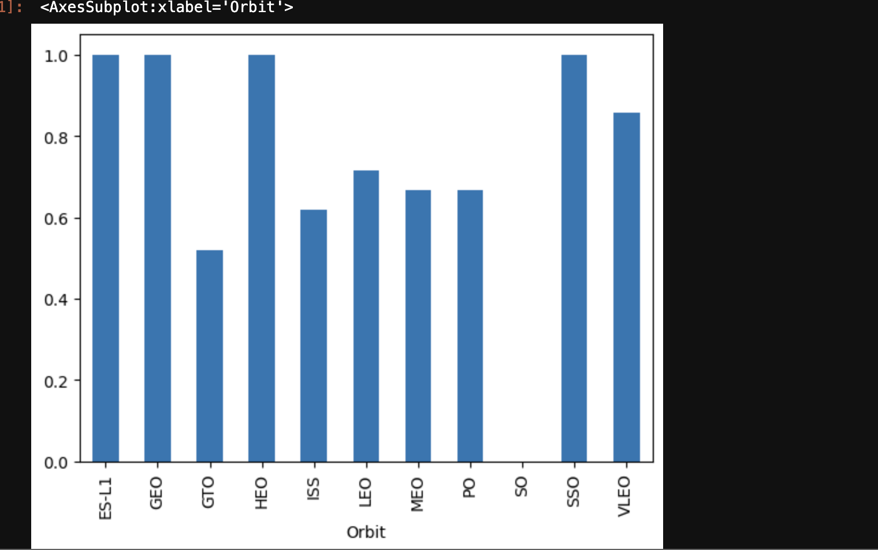
Success Rate vs. Orbit Type
ESL1, GEO,HEO,SSO are the most successful
SO is the least successful
Most orbits are at least passably successful
Show the screenshot of the scatter plot with explanations

Slide 21
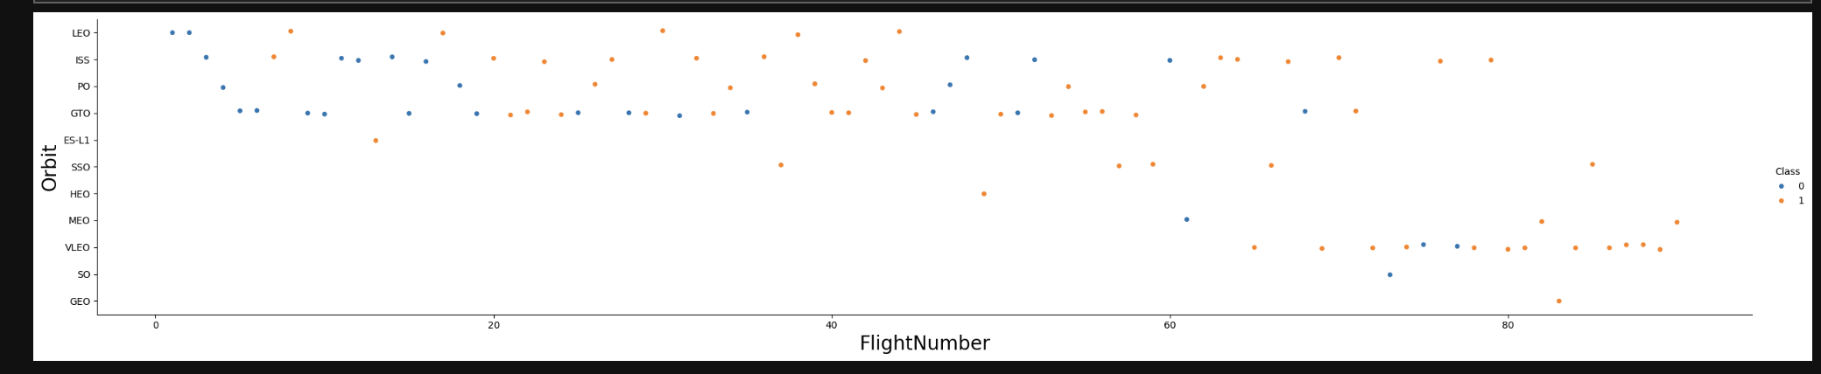
Flight Number vs. Orbit Type
On some orbits correlation is obvious such as LEO or ESL1 on orbits like ISS however the correlation is not as clear
Show the screenshot of the scatter plot with explanations

Slide 22
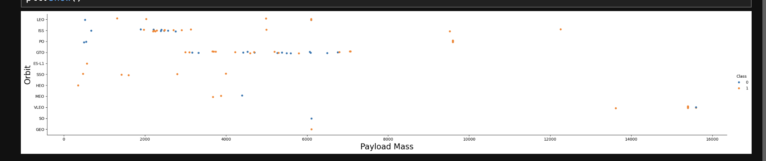
Payload vs. Orbit Type
As we can see even here across the board payload leads to greater success
Show the screenshot of the scatter plot with explanations

Slide 23
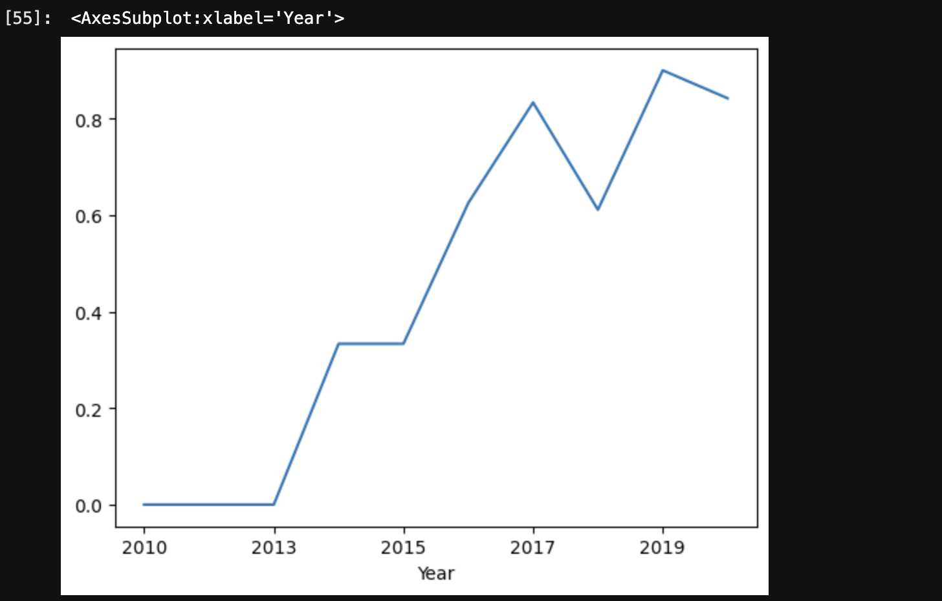
Launch Success Yearly Trend
It had a massive rise from 2013 to 2017 before levelling off in success around 2019-2020
Show the screenshot of the scatter plot with explanations

Slide 24
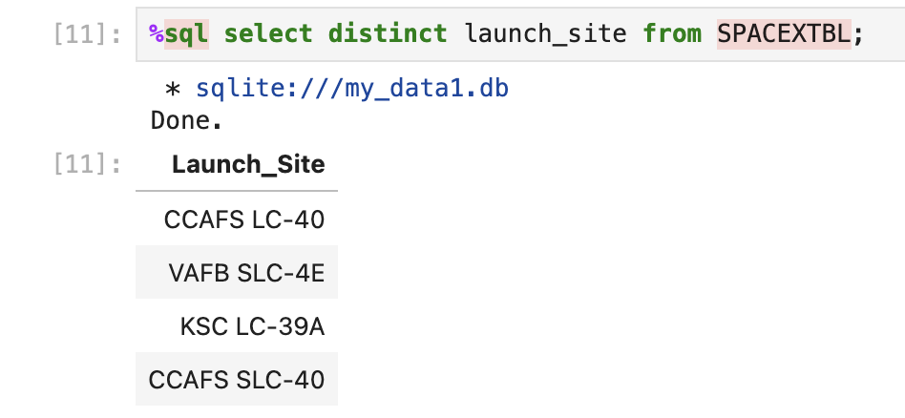
All Launch Site Names
Find the names of the unique launch sites
The Launch sites are CCAFS LC-40
VAFB SLC-4E
KSC LC-39A
CCAFS SLC-40
Present your query result with a short explanation here

Slide 25
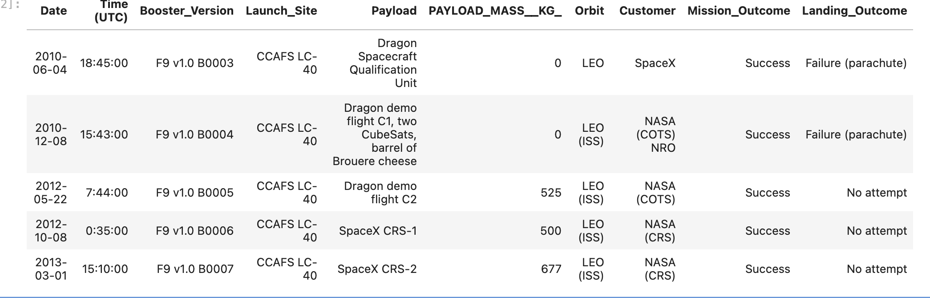
Launch Site Names Begin with 'CCA'
Find 5 records where launch sites begin with `CCA`
5 records where launch sites begin with CCA
Present your query result with a short explanation here

Slide 26
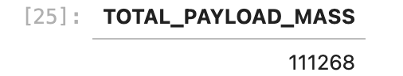
Total Payload Mass
Calculate the total payload carried by boosters from NASA
Present your query result with a short explanation
The total payload mass is 111268kg

Slide 27
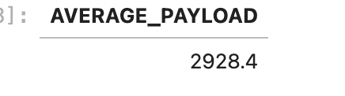
Average Payload Mass by F9 v1.1
Calculate the average payload mass carried by booster version F9 v1.1
The average payload is 2928.4kg
Present your query result with a short explanation here

Slide 28
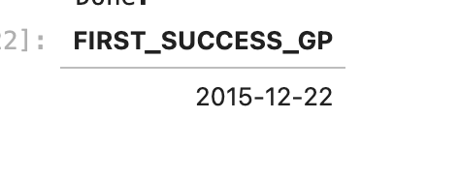
First Successful Ground Landing Date
Find the dates of the first successful landing outcome on ground pad
Present your query result with a short explanation here
First Successful Ground Landing Date was 2015-12-22

Slide 29
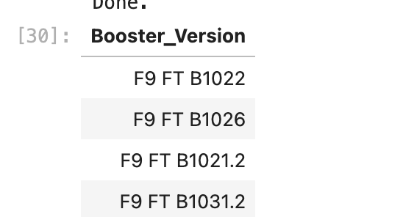
Successful Drone Ship Landing with Payload between 4000 and 6000
List the names of boosters which have successfully landed on drone ship and had payload mass greater than 4000 but less than 6000
These are the booster versions that have done it
Present your query result with a short explanation here

Slide 30
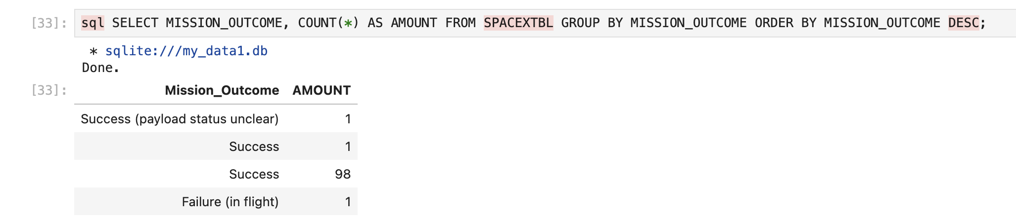
Total Number of Successful and Failure Mission Outcomes
Calculate the total number of successful and failure mission outcomes
Present your query result with a short explanation here
As we can see the vas majority have been highly successful operations

Slide 31
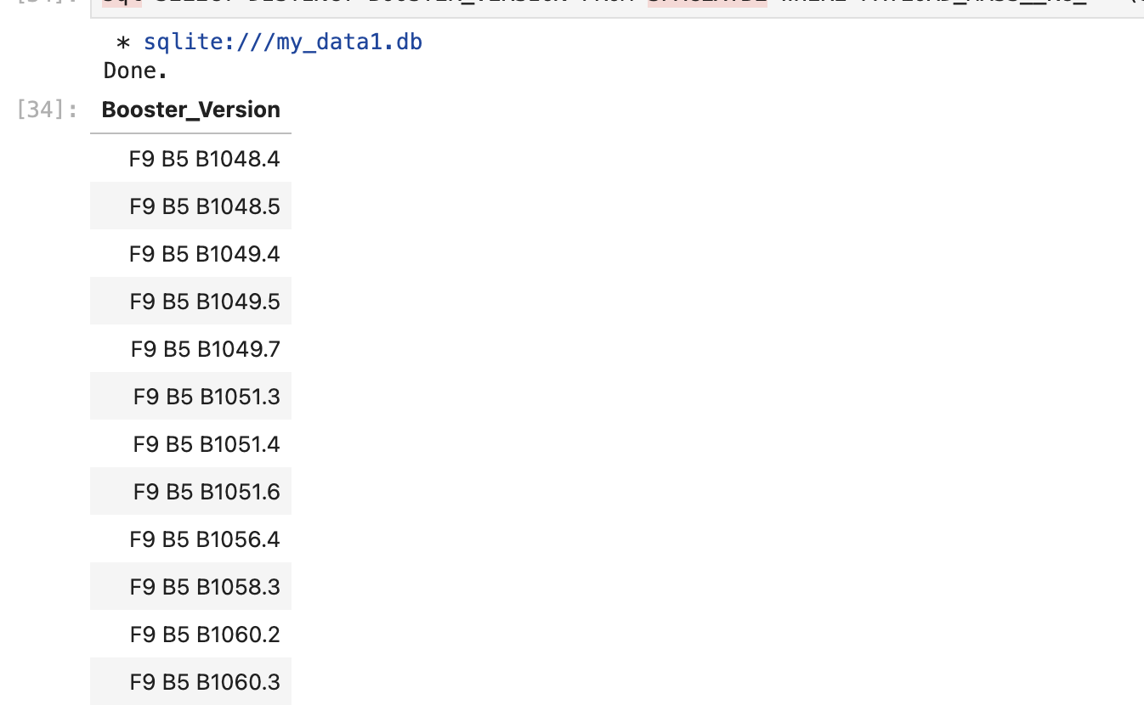
Boosters Carried Maximum Payload
List the names of the booster which have carried the maximum payload mass
As we can see many boosters have carried the maximum payload mass
Present your query result with a short explanation here

Slide 32
2015 Launch Records
List the failed landing_outcomes in drone ship, their booster versions, and launch site names for in year 2015
Present your query result with a short explanation here

Slide 33
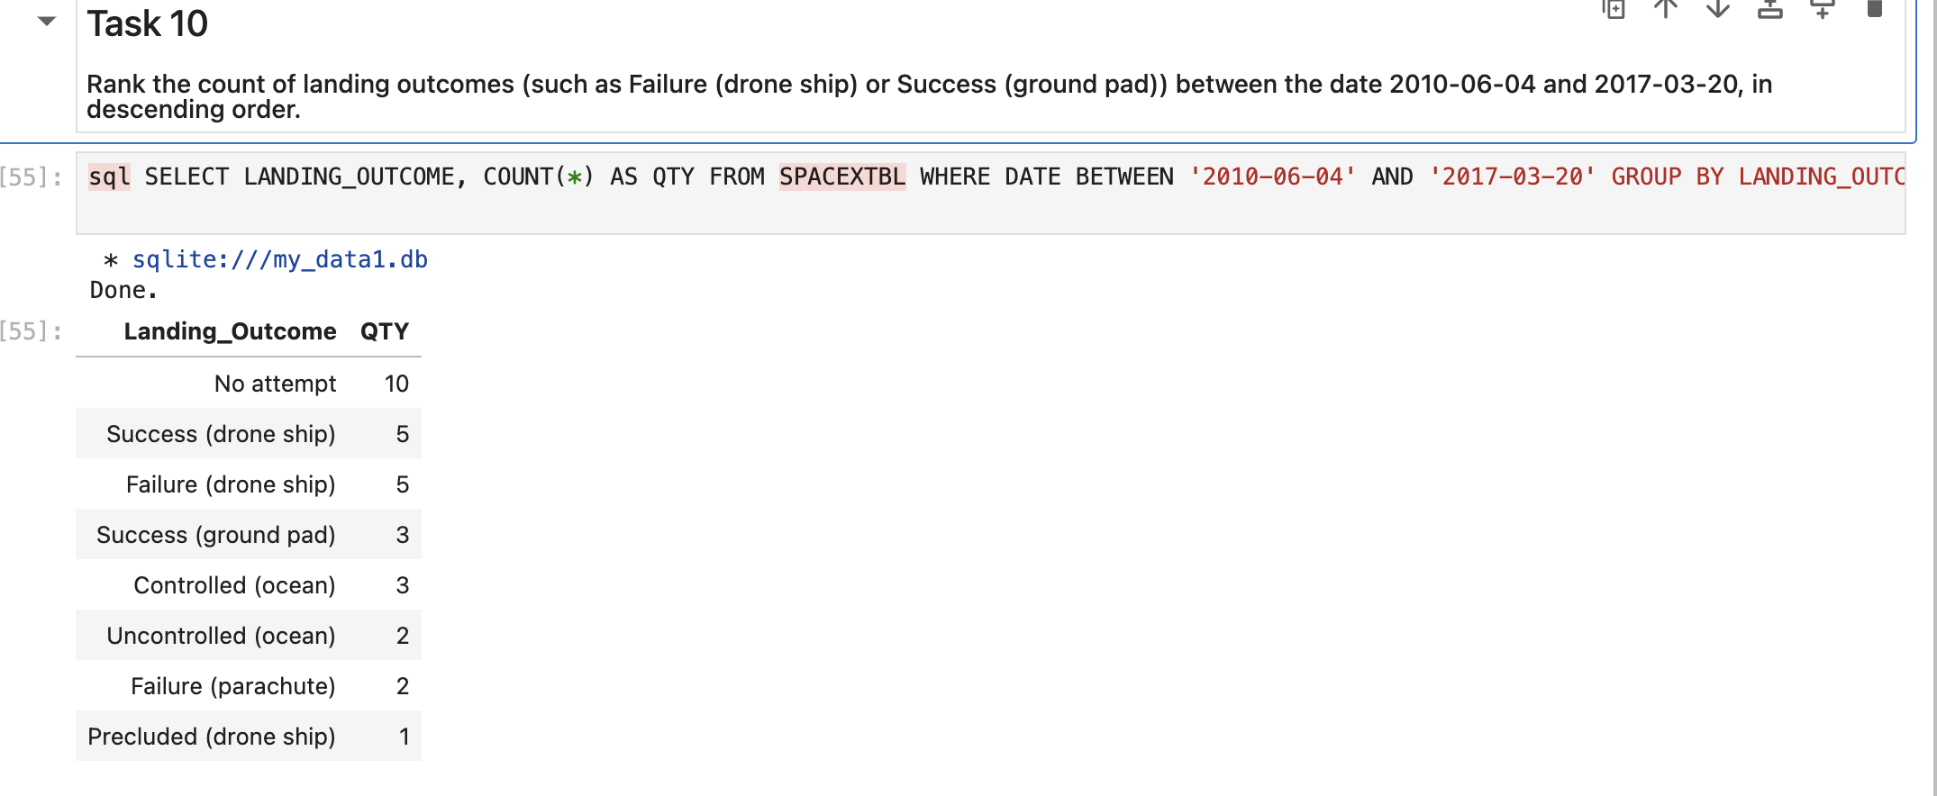
Rank Landing Outcomes Between 2010-06-04 and 2017-03-20
Rank the count of landing outcomes (such as Failure (drone ship) or Success (ground pad)) between the date 2010-06-04 and 2017-03-20, in descending order
There have been all sorts of landing outcomes over the tears
Present your query result with a short explanation here

Slide 34

Section 3

Slide 35
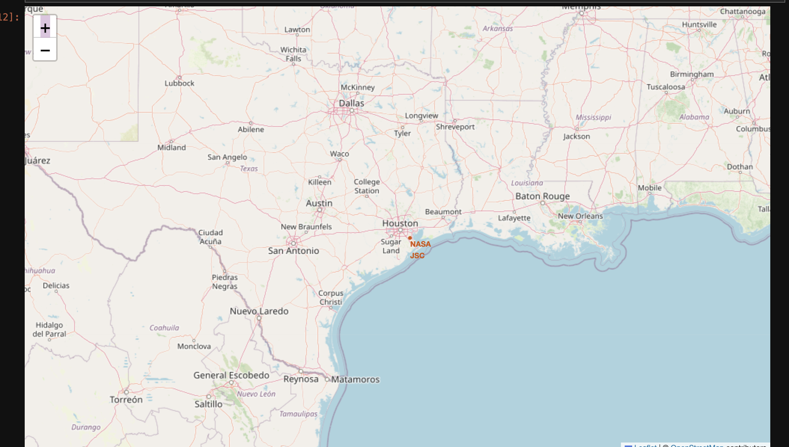
Launch Sites
As we see here the launch site is close to sea and all over the place when you look at the coastline
Explore the generated folium map and make a proper screenshot to include all launch sites’ location markers on a global map
Explain the important elements and findings on the screenshot

Slide 36
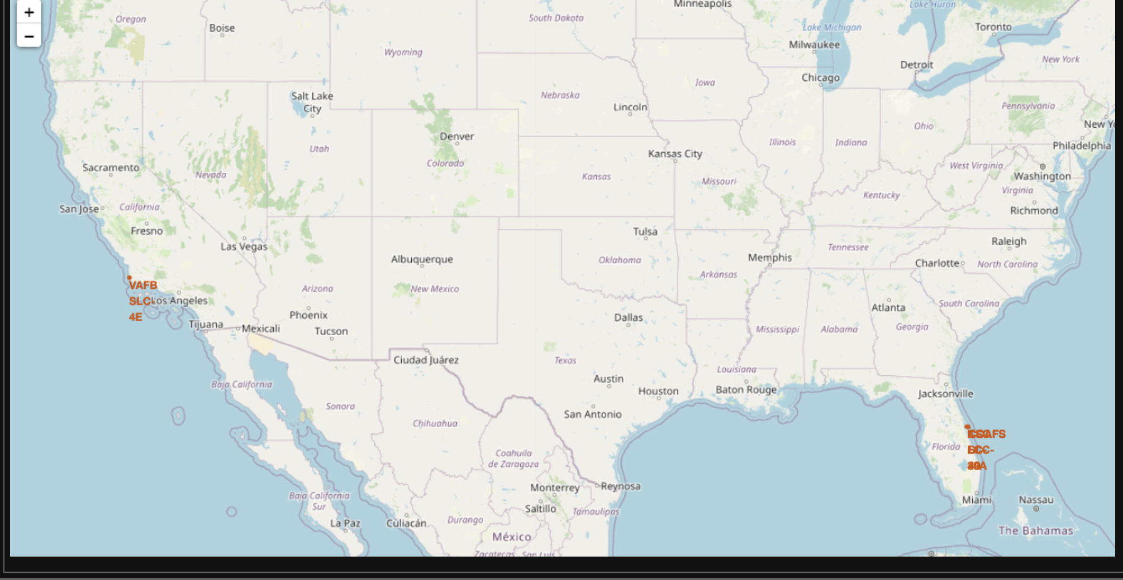
MORE LAUNCH SITES
Replace <Folium map screenshot 2> title with an appropriate title
Explore the folium map and make a proper screenshot to show the color-labeled launch outcomes on the map
Explain the important elements and findings on the screenshot

Slide 37
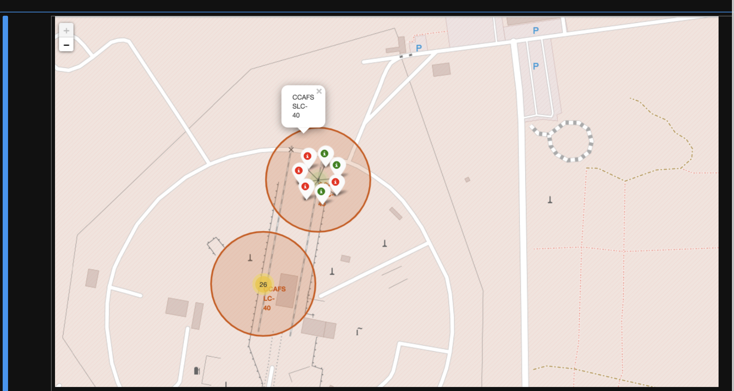
<Folium Map Screenshot 3>
Replace <Folium map screenshot 3> title with an appropriate title
Explore the generated folium map and show the screenshot of a selected launch site to its proximities such as railway, highway, coastline, with distance calculated and displayed
Explain the important elements and findings on the screenshot

Slide 38

Section 4

Slide 39
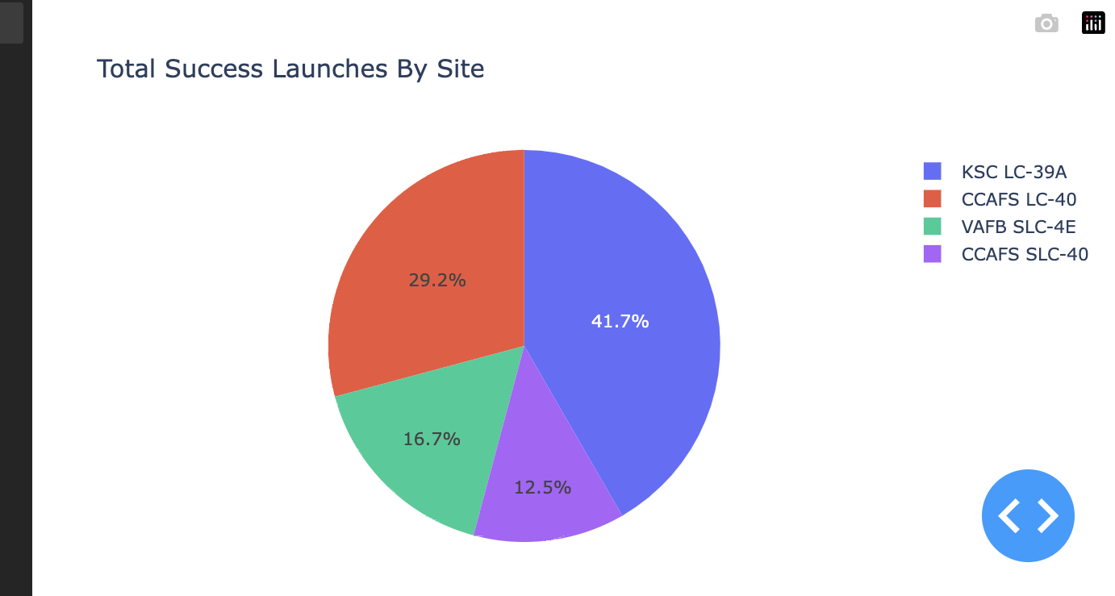
Pie Chart
Here we can see the total launches by site. We can see KSC is the most successful.
CCaFS SLC is the least successful
Show the screenshot of launch success count for all sites, in a piechart
Explain the important elements and findings on the screenshot

Slide 40
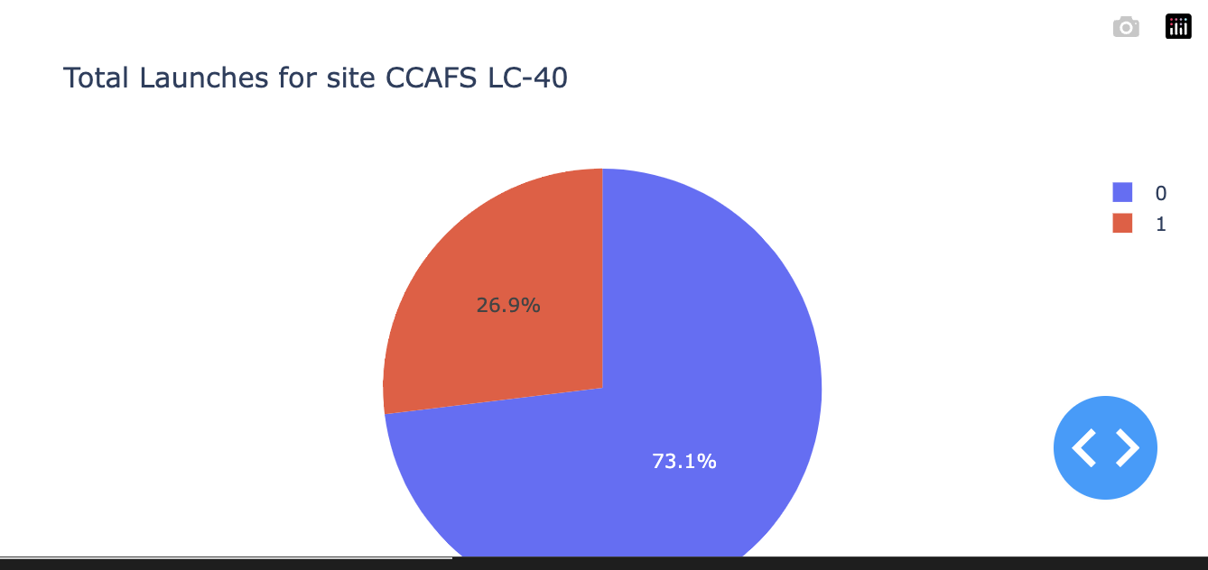
<Dashboard Screenshot 2>
We can see that for CCAFS LC-40 specifically the majority of launches are successful
Show the screenshot of the piechart for the launch site with highest launch success ratio
Explain the important elements and findings on the screenshot

Slide 41
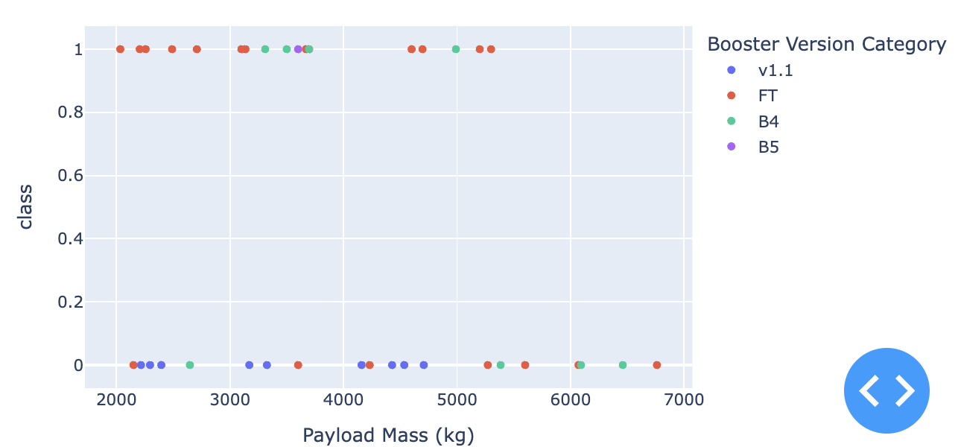
<Dashboard Screenshot 3>
As we can see here We can see here that with this range there are more successes than failures
Show screenshots of Payload vs. Launch Outcome scatter plot for all sites, with different payload selected in the range slider
Explain the important elements and findings on the screenshot, such as which payload range or booster version have the largest success rate, etc.

Slide 42

Section 5

Slide 43
Classification Accuracy
Visualize the built model accuracy for all built classification models, in a bar chart
Find which model has the highest classification accuracy

Slide 44
Confusion Matrix
Show the confusion matrix of the best performing model with an explanation

Slide 45
Conclusions
Point 1
Point 2
Point 3
Point 4
…

Slide 46
Appendix
Include any relevant assets like Python code snippets, SQL queries, charts, Notebook outputs, or data sets that you may have created during this project

Slide 47


